Slide 1
TECHNICAL REFERENCE MANUAL

Slide 3
TABLE OF CONTENTS
Installation procedures | 3
Theft, security and reporting | 10
Worldwide coverage | 13
Device security protocal | 17
System architecture | 18

Slide 4
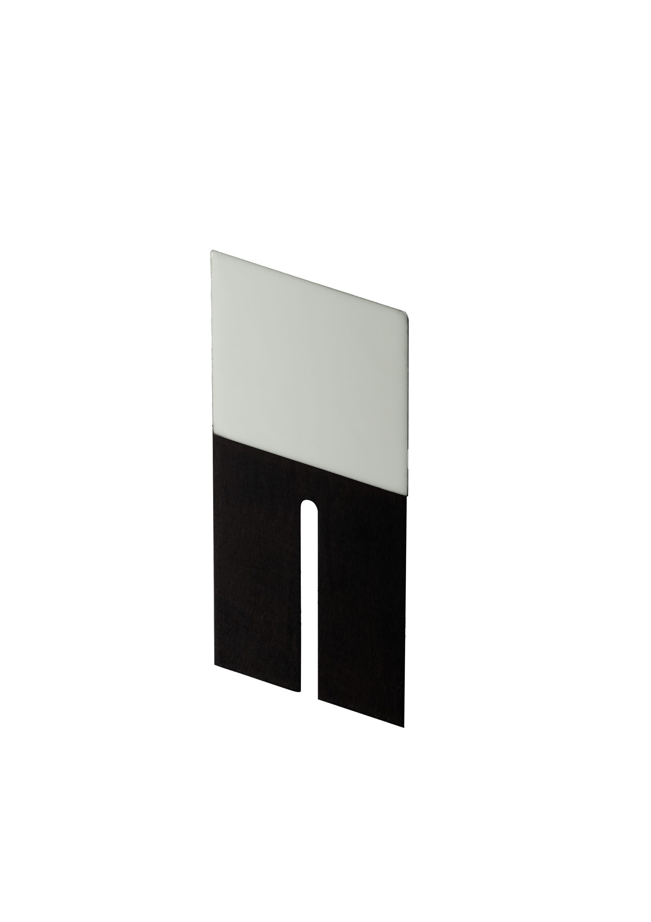
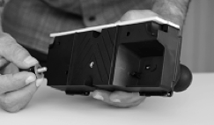
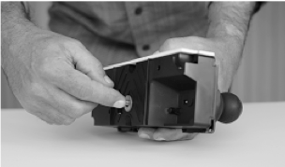
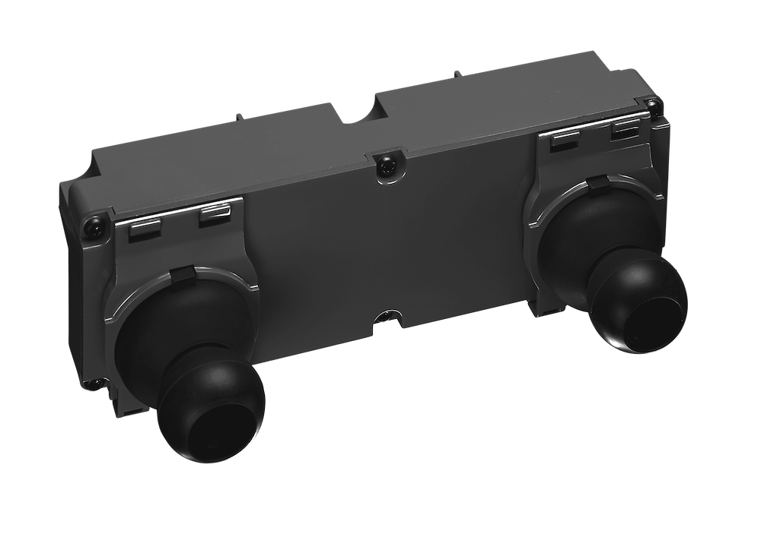
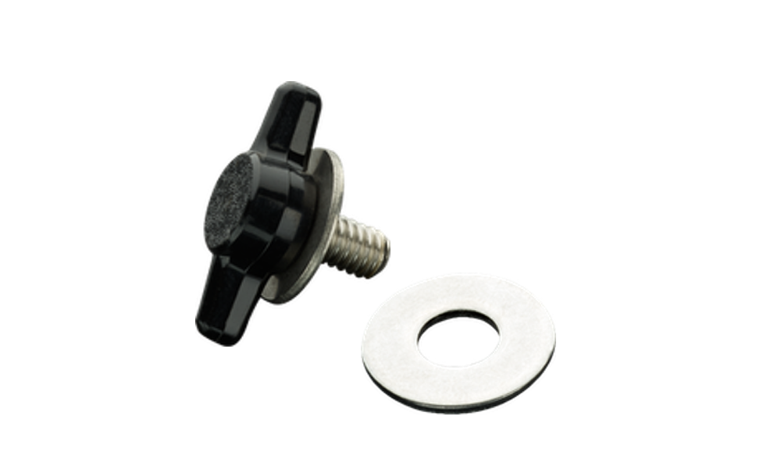
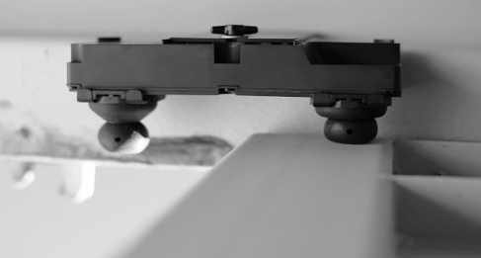
INSTALLATION PROCEDURES
 | Thread the bolt with the washer to back of the unit.
 | Fasten the bolt with 2-3 rotations only.
 | Peel off protective liner from adhesive tape on the alignment tool. Place the mounting bracket in the centre of the container door opening. align its top edge flush with the top of the frame and press to adhere.
 | With the alignment tool already attached and centred on the top frame, peel off protective liner from the adhesive tape on the unit.
 | Align the unit with the alignment tool, making sure the bolt and the washer are loose enough to allow the unit slide up the slot. Push the unit upward until the adhesive makes full contact with the frame and tighten the bolt.
 | For best results, ensure full adhesion before closing container doors. Once the unit has been fastened to the top frame, remove the activation slip to initiate the device.
 | Close the left door. Make sure that the right “rubber boot” on the unit is flush with the left door frame. The unit is now correctly installed and the containers doors can be sealed for transport.
EyeSeal Unit
Mounting Bracket
Bolt & Washer
Bolt &
Washer

Slide 5
RECOMMENDED STEPS FOR CONFIRMATION SECURITY
Once the Unit is properly installed following the Installation Protocol instructions included here, we recommend clients take a few steps to protect the integrity of the Device and avoid third parties interfering and/or tampering with the device.
Once the Unit is installed, the Client should close both doors, take a picture and note the exact time.
Then the Client should check the Back End Server to confirm both doors show "Locked" and "Dark".
The Client should then make sure the time of the notifications match the notifications when the doors were closed.
We recommend the Client wait approximately 3 minutes after closing the doors and confirming with the Back End Server and then reopen both doors and close them again in 3 minutes.
As a final Security measure we recommend the Client repeat the above steps before the container leaves the facilities. This last check is often days after the installation. The objective is that the Units were not tampered and or physically moved by third parties.

Slide 6
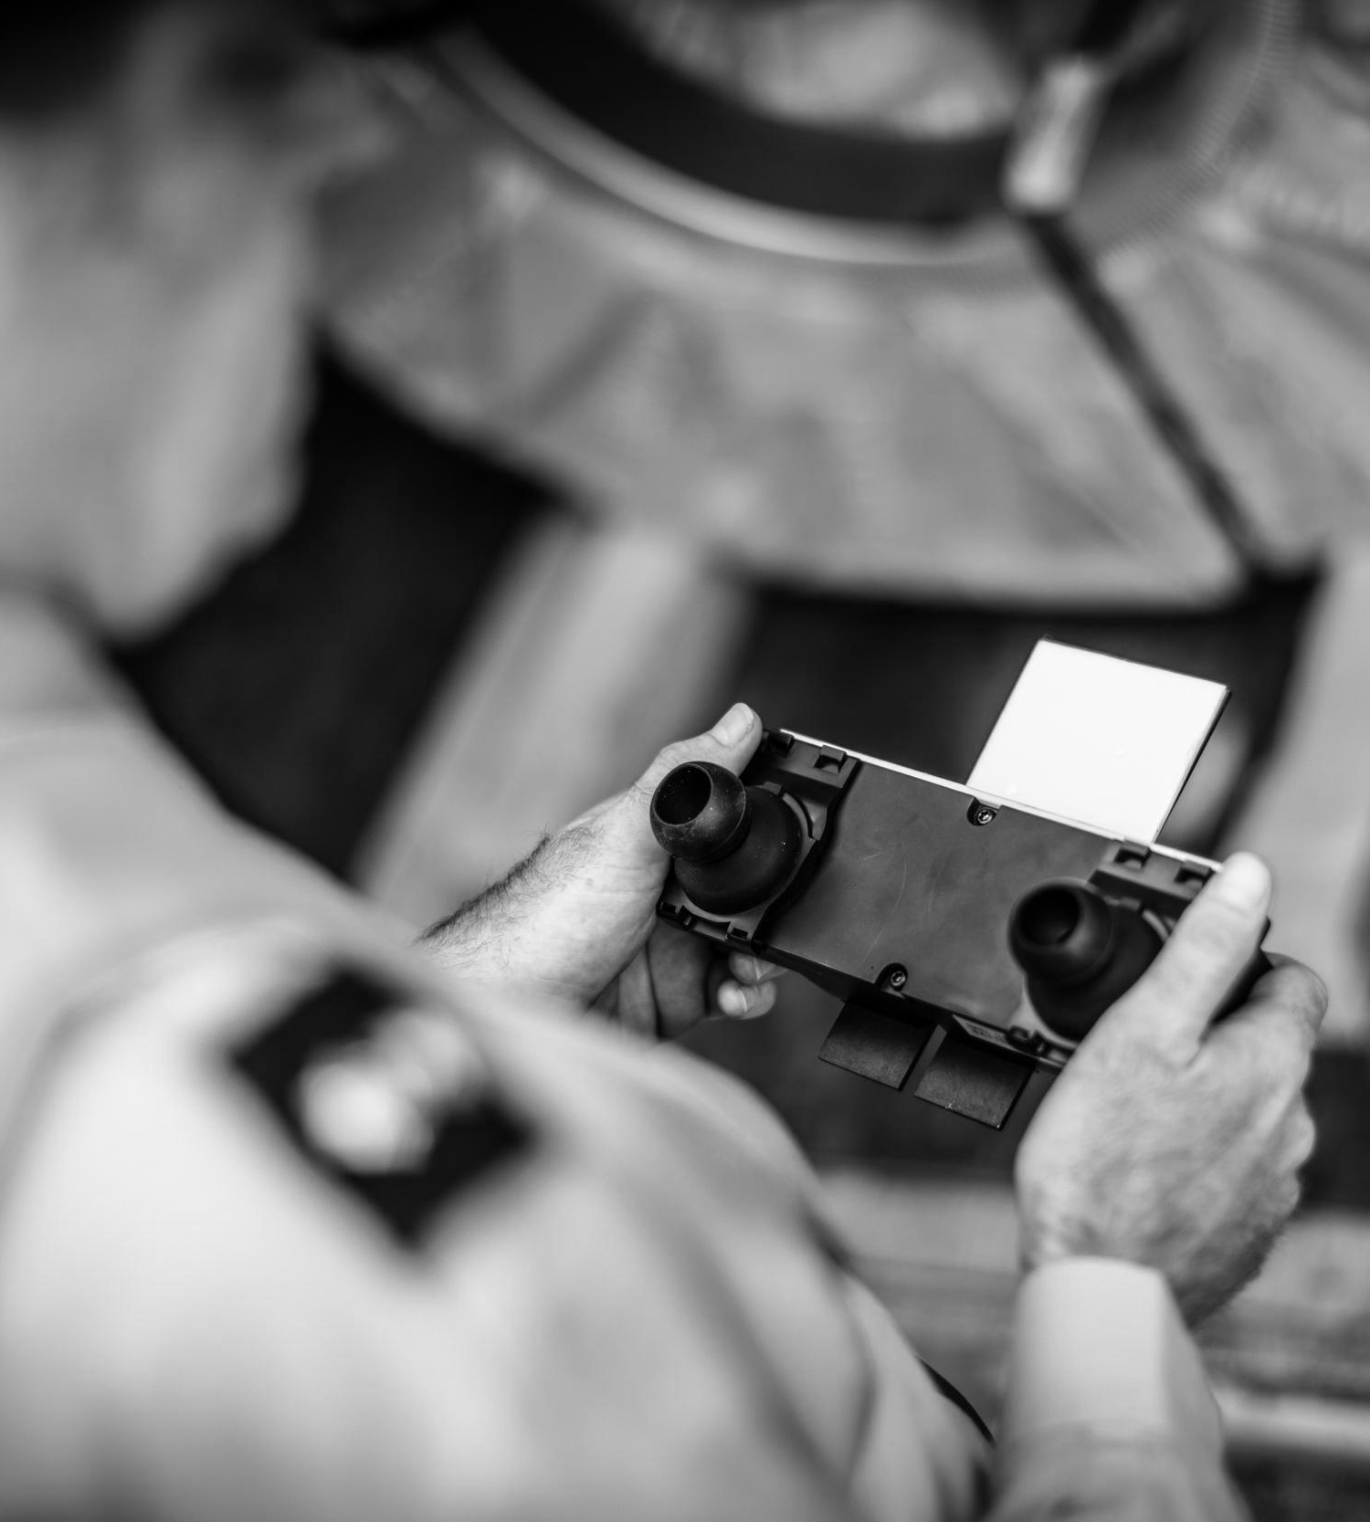
HYPOTHETICAL EXAMPLE
A European shipment with reload in Antwerp with a container scenario on a load that would contain the Eye-Seal solution with the current six-hour report....
1 | A High Value MSA Container is loaded at ABC Yard and is ready for delivery to the Pier. All documentation is final and ready.
2 | ABC Office Operator takes an Eye-Seal from inventory – in the box – turned “OFF".
3 | ABC Operator now initializes the Unit by removing the plastic sensor cover and wait for Message # 1 on the UI – This initial message will confirm proper connectivity and function.
4 | After the Unit and UI are confirmed, ABC Operator hands off the Unit to “Warehouse Staff” for mounting - we can expect random messages during this time as the unit is handled prior to mounting.

Slide 7
5 | The designated warehouse staff installs the Unit as per the Installation Protocols provided. Time is given for adhesive to cure.
6 | Next, once the Unit is installed, the doors of the container should be closed and the time properly and accurately recorded (we always recommend a picture with time). The UI MUST receive a message confirming both doors closed and dark.
7 | At this point the container may sit at ABC Yard for several days as required. Any authorized or unauthorized breaches will be recorded and reported via an immediate ALERT. The Units will also report all internal parameters every six hours.

Slide 8
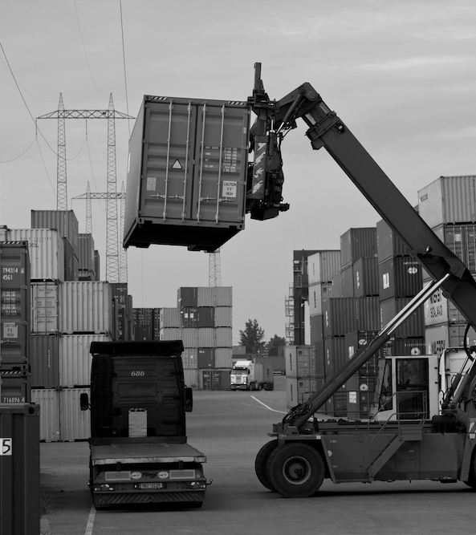
8 | The container is ready to depart ABC Warehouse for PIER: ABC Office Operator should check the UI for any messages or alerts received between the time the Unit was installed and the proposed exit time. The history of the container (and all internal environmental parameters) and device from loading can be viewed at this time.
9 | ABC Office Operator / Security Personnel will meet the container at facility exit for a final door / UI check to be performed. The Office / Security Operator will have a portable connected device with access to the UI.
10 | At this point the container may sit at ABC Yard for several days as required. Any authorized or unauthorized breaches will be recorded and reported via an immediate ALERT. The Units will also report all internal parameters every six hours.

Slide 9
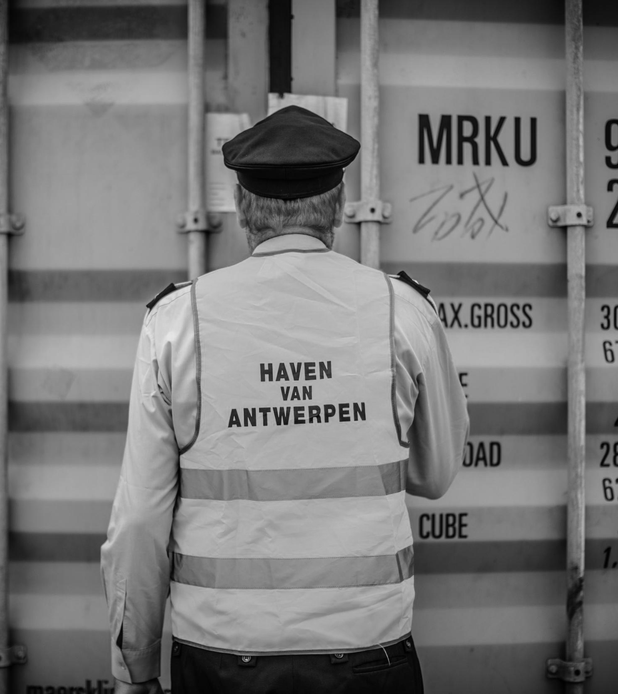
11 | ABC Office Operator / Security Personnel will be responsible for a visual inspection of the Unit and will need to verify this final Door Open notifications on the UI via a message received.
12 | Doors are now to be closed, DOORS CLOSED, and LIGHT OFF event should be received.
13 | If no message is received – re-check the Unit, perform the operation of doors open, and close once again.

Slide 10
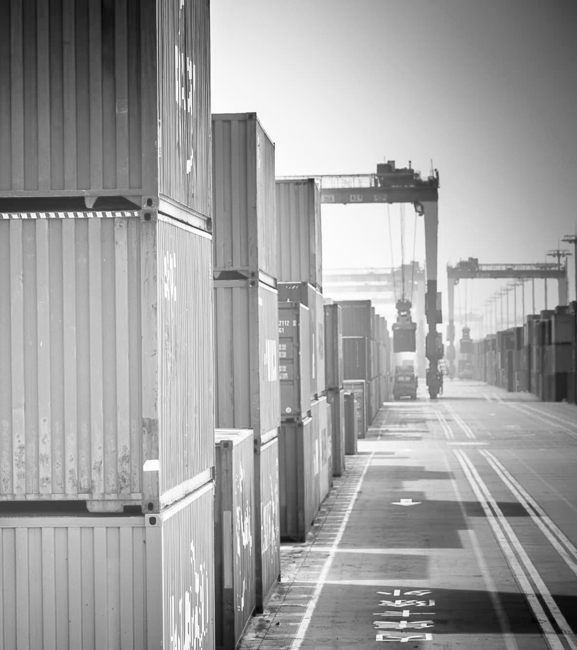
The container will now report every six hours until departure on vessel. As per your observation, if a 6-hour message is not received, the UI may prompt an ‘amber’ reminder to bring attention to the container.
In case of a breach through the doors or through a wall, ceiling, or floor that causes a light fluctuation the Unit will immediately record the activity and send an ALERT message. In case the first message fails, the Units will try three more times at 15-minute intervals to re-establish a connection.
If a theft has occurred and the signals were somehow blocked or tampered with, the first opportunity for contact will be with the retry logic. The second opportunity for contact would be during the next scheduled message, which would contain the date, time, and location stamps of any actions that occurred while no signal was available.
This message would include all the sensor and communications data.

Slide 11
HYPOTHETICAL THEFT EXAMPLE

Slide 12
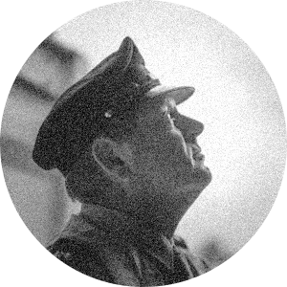
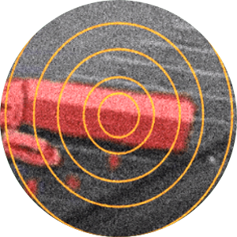
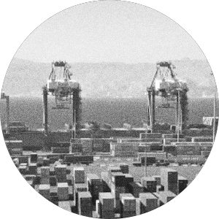
12/12/18 - 13:00
ABC Personnel inspects cargo, checks Unit mounted and performs the "exit" verification test: Opening and closing doors to confirm notifications are accurate on the UI.
12/12/18 - 14:30
The Doors are opened and the theft begins and lasts for 120 minutes.
The breach will trigger an immediate alert and the radio will start immediate transmission. The Unit will also record this Alert into Memory, which cannot be accessed externally (one way SIM card attribute).
12/12/18 - 14:00
On route to the Port, the drivers are deviated from the approved route and take the truck and container to a warehouse in order to remove (steal) contents from the container.

Slide 13
Our UI will allow you to provide access to as many individuals in your logistics chain that you wish to include. Including Security, Forwarders, Insurance, Consignee, Transport managers. Anyone that you allow access to the UI now has access to these reports and details.
Your team will have full details for the following key points:
Date and time door originally closed after loading.
Full history of container condition from loading unit
inspection at warehouse exit..
Exit Message prior to leaving the warehouse including full history from loading.
Scheduled messages every six hours with full date time, and location stamp (including environmental parameters).
Immediate alerts upon both authorized and unauthorized breaches.
If the 6 Hour schedule is maintained – the Eye-Seal can provide this coverage for 120 days internationally. The device parameters and interval is established when the device is ordered.
With these key date, time, and locations stamps combined with the actions observed by the sensors, Law Enforcement and Insurance can define a specific timeline and location. The Custody of the container will be known and thus responsibility properly assigned.
When thefts are undetected for several days, weeks or months, the cargo has passed through the hands of several players along perhaps international borders and jurisdictions. At this point it is nearly impossible to identify the Custodian of the Cargo when the said breach occurred.
However, In the Maritime field, a six hour window is a short time frame to properly make an exchange of Custody. The Custodian will be identified with the Time and Date Stamp.

Slide 14
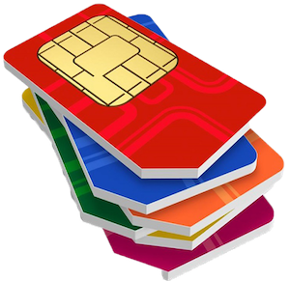
SIM CARD WORLDWIDE COVERAGE

Slide 15
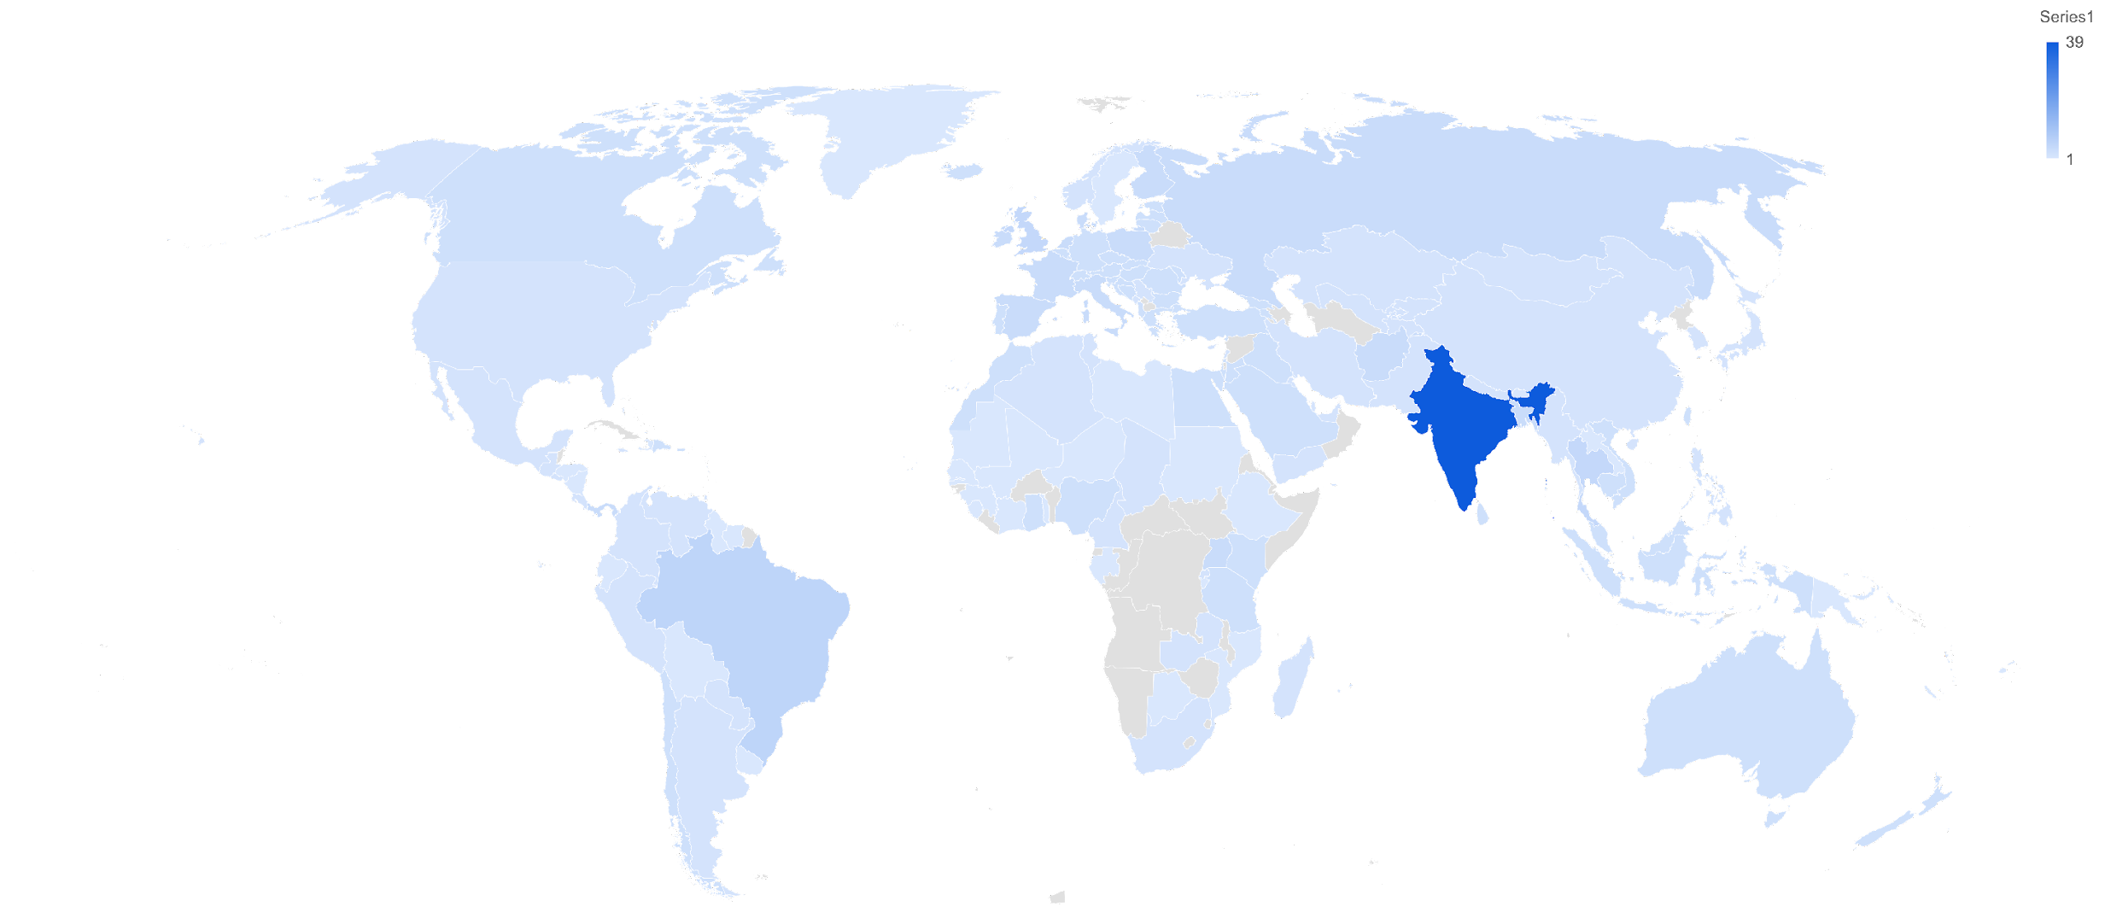
GLOBAL GSM COVERAGE & NUMBER OF LOCAL OPERATORS
 |  |  |  |  |  |  |  | Kenya | 3 | Puerto Rico | 3
 |  |  |  |  |  |  |  | Kuwait | 2 | Qatar | 2
 |  |  |  |  |  |  |  | Kyrgyzstan | 2 | Reunion | 1
 |  |  |  |  |  |  |  | Laos | 1 | Romania | 3
 |  |  |  |  |  |  |  | Latvia | 3 | Russia | 4
 |  |  |  |  |  |  |  | Lebanon | 2 | Rwanda | 2
 |  |  |  |  |  |  |  | Libya | 1 | Saudi Arabia | 3
 |  |  |  |  |  |  |  | Liechtenstein | 1 | Senegal | 1
 |  |  |  |  |  |  |  | Lithuania | 3 | Serbia | 2
 |  |  |  |  |  |  |  | Luxembourg | 3 | Seychelles | 1
 |  |  |  |  |  |  |  | Macao | 2 | Sierra Leone | 1
 |  |  |  |  |  |  |  | Macedonia Republic of | 2 | Singapore | 3
 |  |  |  |  |  |  |  | Madagascar | 2 | Slovakia | 3
 |  |  |  |  |  |  |  | Malaysia | 3 | Slovenia | 3
 |  |  |  |  |  |  |  | Maldives | 2 | South Africa | 2
 |  |  |  |  |  |  |  | Mali | 1 | South Korea | 2
 |  |  |  |  |  |  |  | Malta | 3 | Spain | 4
 |  |  |  |  |  |  |  | Martinique | 1 | Sri Lanka | 3
 |  |  |  |  |  |  |  | Mauritania | 1 | St Kitts Island | 1
 |  |  |  |  |  |  |  | Mauritius | 3 | St Lucia Island | 1
 |  |  |  |  |  |  |  | Mexico | 2 | St Vincent Island | 1
 |  |  |  |  |  |  |  | Moldova Republic of | 3 | St. Maarten | 1
 |  |  |  |  |  |  |  | Monaco | 1 | Sudan | 1
 |  |  |  |  |  |  |  | Mongolia | 2 | Suriname | 1
 |  |  |  |  |  |  |  | Montenegro | 2 | Sweden | 1
 |  |  |  |  |  |  |  | Montserrat Island | 1 | Switzerland | 3
Afghanistan | 4 | Botswana | 1 | Dominica Island | 1 | Guatemala | 2 | Morocco | 3 | Taiwan | 3
Albania | 3 | Brazil | 6 | Dominican Republic | 3 | Guernsey | 1 | Mozambique | 1 | Tajikistan | 2
Algeria | 2 | British Virgin Islands | 2 | Ecuador | 1 | Guinea | 1 | Myanmar | 2 | Tanzania | 3
Andorra | 1 | Brunei Darussalam | 1 | Egypt | 3 | Guyana | 1 | Nepal | 2 | Thailand | 5
Anguilla Island | 1 | Bulgaria | 3 | El Salvador | 2 | Haiti | 1 | Netherlands | 4 | Togo | 1
Antigua | 1 | Burundi | 1 | Estonia | 3 | Honduras | 1 | New Caledonia | 1 | Tonga | 1
Argentina | 2 | Cambodia | 3 | Ethiopia | 1 | Hong Kong | 6 | New Zealand | 3 | Trinidad and Tobago | 2
Armenia | 3 | Cameroon | 2 | Faroe Islands | 1 | Hungary | 3 | Nicaragua | 1 | Tunisia | 2
Aruba | 1 | Canada | 3 | Fiji | 1 | Iceland | 3 | Niger | 1 | Turkey | 3
Australia | 3 | Cape Verde | 2 | Finland | 4 | India | 39 | Nigeria | 3 | Turks Island | 1
Austria | 3 | Cayman Islands | 1 | France | 4 | Indonesia | 3 | Norway | 2 | Uganda | 4
Azerbaijan Rep of | 1 | Chad | 2 | French Guyana | 1 | Iran | 2 | Oman, Sultanate of | 2 | Ukraine | 2
Bahamas | 1 | Chile | 3 | French West Indies | 2 | Iraq | 3 | Over the air | 2 | United Arab Emirates | 2
Bahrain | 2 | China | 2 | Gabon | 1 | Ireland | 4 | Over the sea | 5 | United Kingdom | 5
Bangladesh | 4 | Colombia | 2 | Gambia | 1 | Isle of Man | 2 | Pakistan | 2 | Uruguay | 1
Barbados | 1 | Congo Democratic Rep of | 3 | Georgia | 3 | Israel | 3 | Palestine | 2 | USA | 2
Belarus Rep of | 3 | Costa Rica | 2 | Germany | 3 | Italy | 4 | Panama | 4 | Uzbekistan | 2
Belgium | 3 | Cote D'Ivoire | 1 | Ghana | 3 | Ivory Coast | 1 | Papua New Guinea | 1 | Vanuatu | 1
Bermuda | 1 | Croatia | 3 | Gibraltar | 1 | Jamaica | 2 | Paraguay | 2 | Venezuela | 2
Bhutan | 1 | Curacao | 2 | Greece | 3 | Japan | 2 | Peru | 2 | Vietnam | 3
Bolivia | 1 | Cyprus | 2 | Greenland | 1 | Jersey | 3 | Philippines | 2 | Yemen | 2
Bonaire | 1 | Czech Republic | 3 | Grenada Island | 1 | Jordan | 3 | Poland | 4 | Zambia | 2
Bosnia and Herzegovina | 3 | Denmark | 4 | Guam | 1 | Kazakhstan | 2 | Portugal | 3

Slide 16
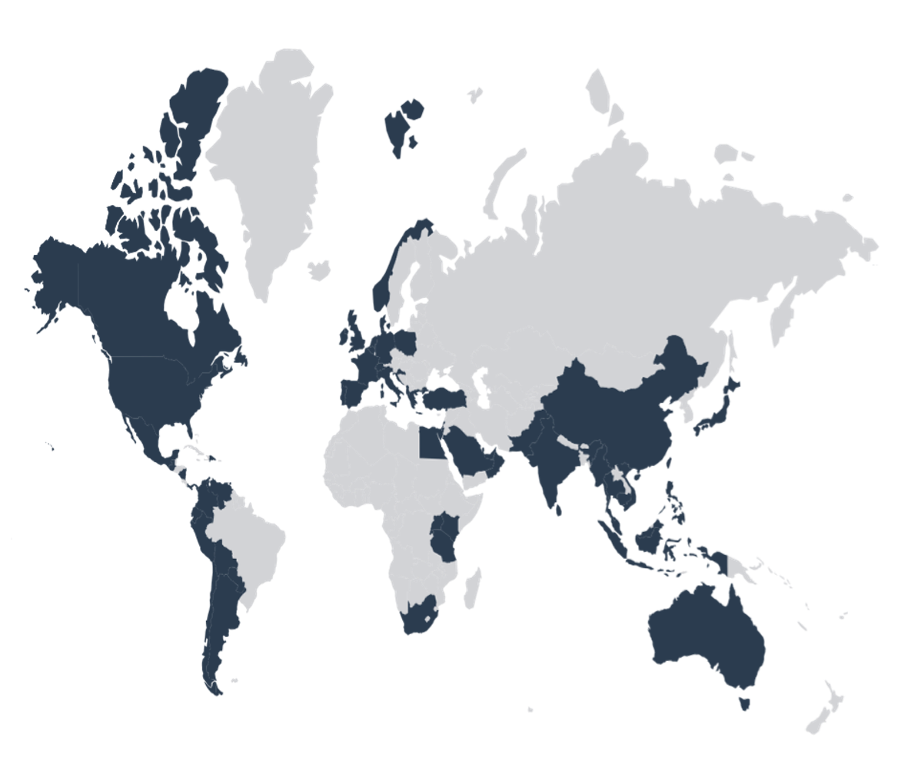
COUNTRIES VISITED IN WORLDWIDE DEPLOYMENTS
ALBANIA
ARGENTINA
AUSTRALIA
BAHAMAS
BELGIUM
BOLIVIA
BRAZIL
CAMBODIA
CANADA
CHILE
CHINA
COLOMBIA
CROATIA
DENMARK
DOMINICAN REPUBLIC
ECUADOR
EGYPT
FRANCE
GERMANY
GREECE
GUATEMALA
HONG KONG
INDIA
INDONESIA
IRELAND
ISRAEL
ITALY
KENYA
MALAYSIA
MALDIVES
MAURITIUS
MEXICO
MYANMAR
NICARAGUA
NORWAY
OMAN
PAKISTAN
PANAMA
PARAGUAY
PERU
PHILIPPINES
POLAND
PORTUGAL
QATAR
REUNION ISLAND
RWANDA
SAUDI ARABIA
SEYCHELLES
SINGAPORE
SOUTH AFRICA
SPAIN
SRI LANKA
SWITZERLAND
TAIWAN
TANZANIA
THAILAND
THE NETHERLANDS
TRINIDAD & TOBAGO
TURKEY
U.S. VIRGIN ISLANDS
UGANDA
U.A.E.
UNITED KINGDOM
URUGUAY
U.S.A.
VENEZUELA
VIETNAM

Slide 17
DEVICE SECURITY PROTOCOL
Data Integrity Measures
OVERVIEW
The Eye-Seal Breach Detection Device (BDD) is located on the lintel of a modular cargo container and monitors the inside of the container for signs of entry using a proprietary set of sensors. The BDD communicates with the Eye-Seal Server on a periodic basis and immediately if a breach occurs.
The BDD in combination with the Eye-Seal Server provide a forensic trail indicating the times when the cargo was accessible through open doors or other means. The purpose of the Data Integrity Measures outlined in this brief are to ensure the forensic integrity of the data provided by the BDD by preventing forged messages.
Methods
The methods used by the BDD include a proprietary sensing system, regular communications with the Server, immediate transmission on all entry and closing events, non-volatile protected storage of all events.

Slide 18
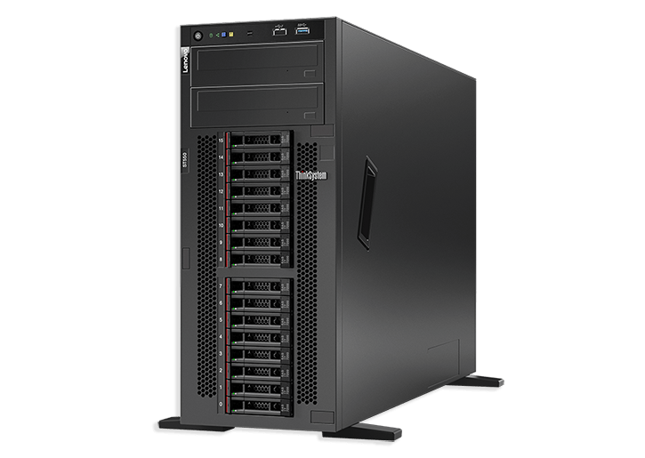
DATA INTEGRITY PROTECTION
The diagram below shows how data is exchanged between the BDD and the Server. The key features of this protocol include:
There is a unique 320 bit session key that is generated by the Server at the beginning of each communication session.
The session key is transmitted to the BDD using XXTEA encryption and a 128 bit key that is created in the factory and is known only to the BDD and the Server.
All data being transmitted is combined with the 320 bit session key and the resulting data stream is used to create a SHA-1 Cryptographic Hash. This Hash is sent with the data to allow the Server to validate the transmitted data.
The key used to protect the XXTEA encryption is stored in protected memory in the BDD and protected by an 80 bit access code. If an attempt is made to access the memory using an incorrect access code, the memory will be erased.
If tampering is suspected the non-volatile data log contained on the device can be recovered by the Eye-Seal engineering team.
BDD Sends identity to Server
Server replies with XXTEA encrypted 320-bit session key
BDD replies with SHA-1 hash of
pre-agreed data
Server requests status dump
BDD replies with Jason formatted data and SHA-1 hash Jason data + session key
Server acknowledges receipt of data
Server sends disconnect command
BDD acknowledges and disconnects

Slide 19
SYSTEM ARCHITECTURE
Improved architecture includes a CQRS+ES system where we collect events from the devices and store them in an immutable event journal.
We use the journal to project device status updates into an SQL server to power the web site.
This logically disconnects the TCP endpoint from the web site and scales the system. Plus, it gives us a verifiable audit trail of events so we can provide evidence of what a device’s status was at any moment in time.

Slide 20
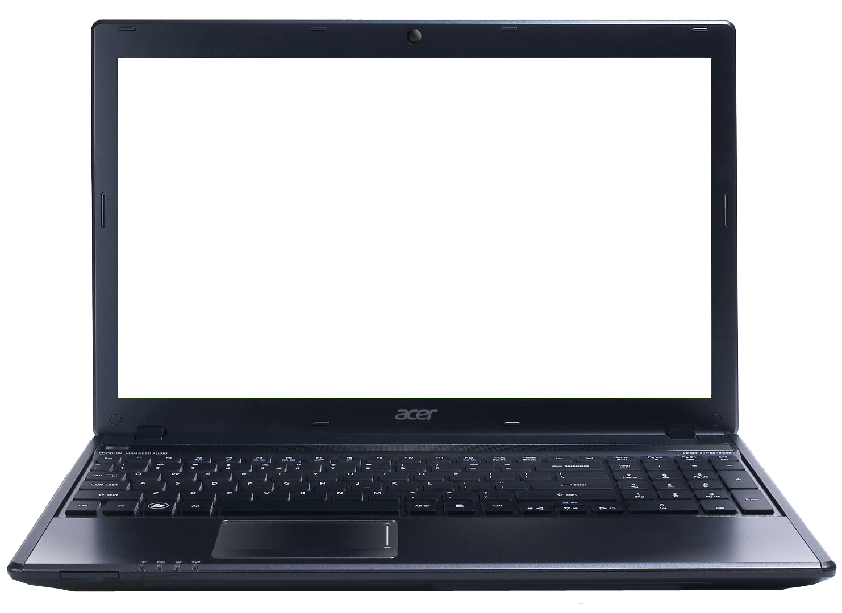
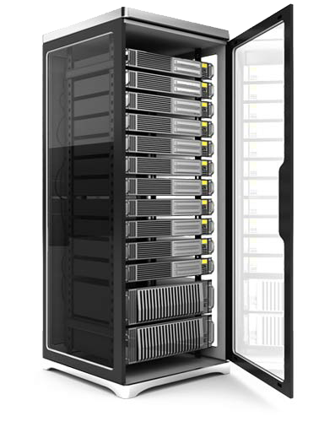
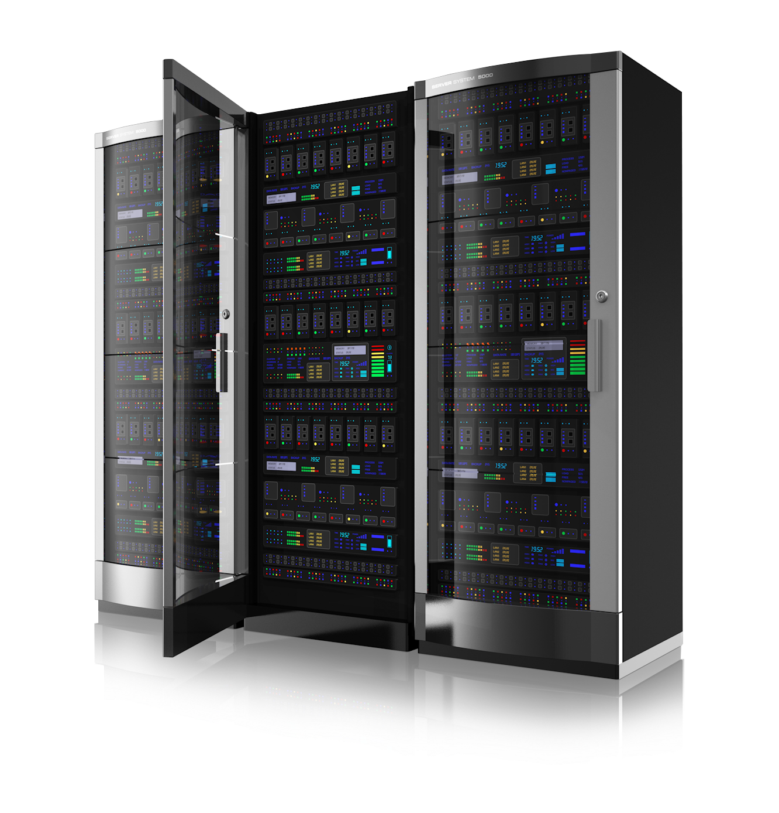
CURRENT PHASE II SYSTEM ARCHITECTURE DIAGRAM
DiscoverTec is in the process of diagramming architecture for Phase III implementation, but the current proposed plan is to implement a CQRS+ES system where we collect events from the devices and store them in an immutable event journal.
We will then use the journal to project device status updates into an SQL server to power the web site.
This would logically disconnect the TCP endpoint from the web site, and it will help make the scaling of the system easier. Plus, it gives us a verifiable audit trail of events so we can prove in court what a device’s status was at any moment in time.
EyeSeal Device
Data at rest
unknown
TCP Server
PORT 63473
Authenticated but not encrypted
HTTP PORT 80
Authenticated
AND fully encrypted
Data at rest stored in SQL server, but not encrypted
HTTP PORT 80
Authenticated
but not encrypted
SQL PORT 1433
Authenticated, firewall secured,
but not encrypted
End User
Web Server
Database Server
No data stored at rest

Slide 21
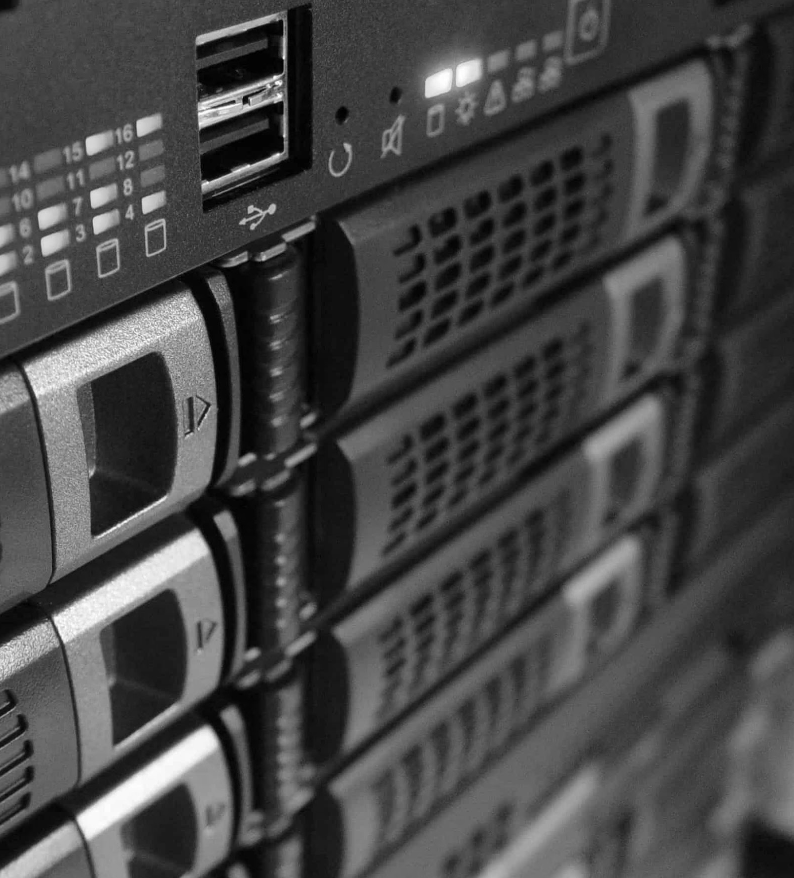
INFRASTRUCTURE AND DATA CENTER SECURITY
Our High-Availability infrastructure is the foundation to providing our customers with the performance and reliability they demand from their applications. What is High-Availability?
High availability implies no human intervention to restore operation in complex systems. DiscoverTec utilizes active redundancy to achieve high availability with no performance decline.
Multiple items of the same kind are incorporated into a design that includes a method to detect failure and automatically reconfigure the system to bypass failed items using a voting scheme.
In addition to our world-class infrastructure, our certified engineers have hardened and scaled the infrastructure to be secure and dynamic. No chokepoints or bottlenecks exist and the infrastructure can scale to any emerging business needs.

Slide 22
SURROUNDING INFRASTRUCTURE
To ensure maximum reliability and performance, the DiscoverTec deployments are located inside two geographically dispersed data centers that have redundant power network infrastructure, and environment control.
Sophisticated systems ensure state-of-the-art Internet security, configuration management, domain and DNS management, backup and restore.
Network, hardware, and software are monitored 24x7, with a 24x7 help desk available to resolve support issues.
A pool of spare servers and hardware components is on hand in the data center to quickly recover from any hardware failure. Data is backed up nightly and stored offsite weekly.
PHYSICAL SECURITY | All servers are located in a cat5 data center with 24x7 guard-controlled access. Identification protocols and biometric scanners are used to authenticate technicians before permitting their entry into the data center. Access is strictly limited to personnel that need to work on servers or infrastructure.
TRANSPORT SECURITY | All communication between your PC and your Hosted Remote Desktop environment is made through SSL. This protocol employs 128-bit encryption to protect your data in transport.
FIREWALL SECURITY | All ports into and out of the data center are blocked except for the few ports necessary to provide access to your solution. Intrusion detection provides added security.
WINDOWS SECURITY | DiscoverTec employs the strictest possible Windows lock-down techniques. Users only have access to the functions required for the functioning of their Hosted Remote Desktop solution, and they are securely separated from all other users in the data center. All servers run Windows 2008 R2 or above and any applicable security patches are applied shortly after they become available.
DATA SECURITY | Databases are kept completely isolated, strong passwords are required, and access is strictly limited.
PASSWORD SECURITY | Strong password requirements are maintained for all deployments. These passwords that are made up of combinations of upper and lowercase letters, symbols and numbers are extremely effective in preventing unauthorized access.
VIRUS SECURITY | Microsoft Forefront software is employed and kept continually up to date to ensure a clean, safe environment.

